Slide 1
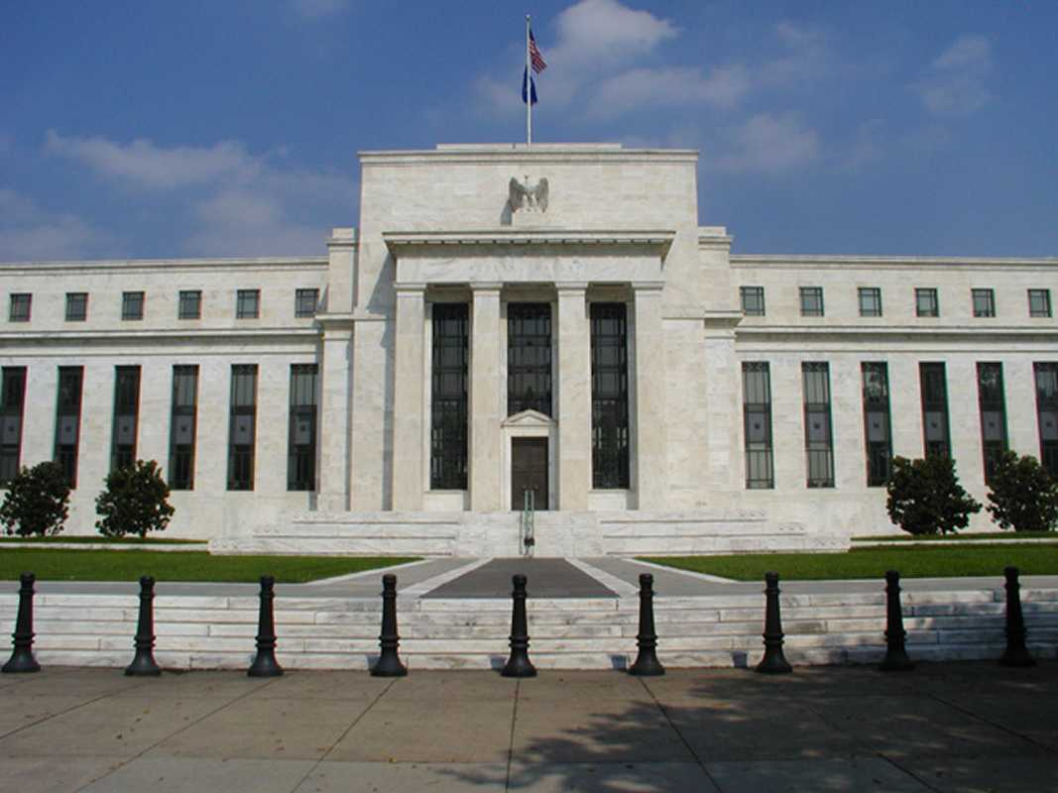
Monetary Policy & The Great Depression

Slide 2
The Federal Reserve System
Central bank of the U.S.
Also known as the Federal Reserve or simply as “the Fed”
Mission:
Macroeconomic stability: low, stable inflation, promote growth in output and employment
Financial stability: ensure the nation’s financial system functions properly, attempts to prevent or mitigate financial crises.

Slide 3
The Federal Reserve System
Monetary Policy Tools of Central Banks:
Macroeconomic stability: can adjust the short-term interest rate to influence spending, production, employment, and inflation.
Financial stability: provide liquidity (short-term loans) to financial institutions to help calm panics, serving as “lender of last resort.”
Comprised of 12 regional banks and the Board of Governors.

Slide 4
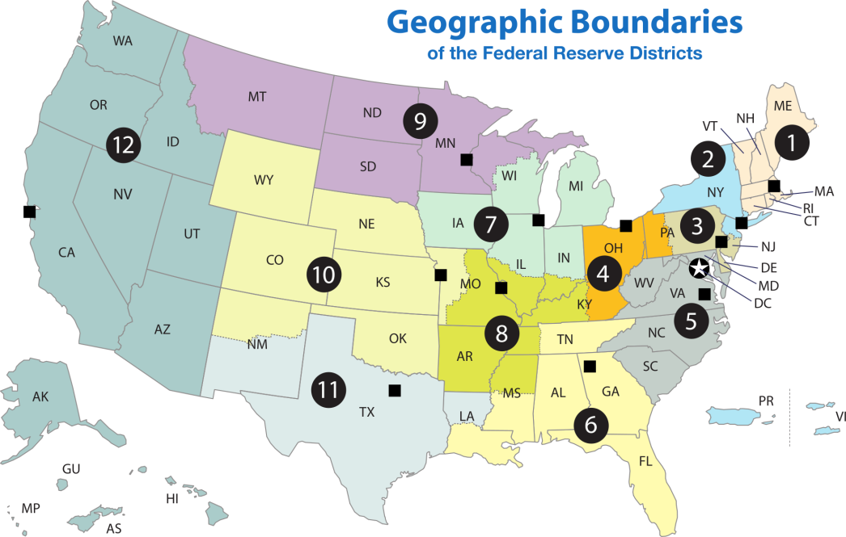
Regional Banks
Regional reserve bank examiners monitor whether banks are taking on too much risk.
Examiners also ensure that banks comply with all state and federal laws.

Slide 5
How does the Fed fit into the three branches of government?

Slide 6
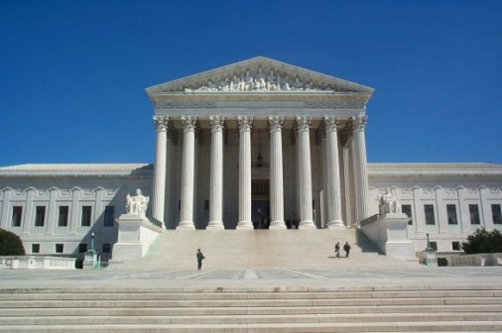
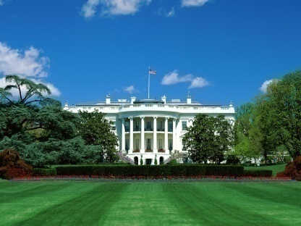
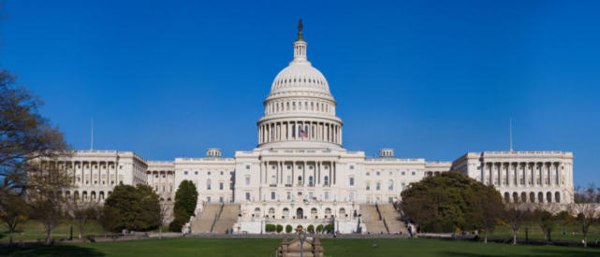

The Fed is an independent agency within the government!
President appoints leadership.
Congress authorizes the Fed to regulate the money supply.
Executive Branch
Legislative Branch
Judicial Branch
The Fed
Notes:
--the Federal Reserve Chairman is appointed by the President; the Governors of the Federal Reserve are also appointed.
--Congress, or the Legislative Branch, confirms or rejects the President’s appointees.
--The Legislative Branch has some oversight of the Fed, as they created it (Federal Reserve Act of 1913)
--The Fed Chairman will testify before congress several times a year to answer questions they have
--Congress cannot tell the Fed what to do about monetary policy; in this way the Fed is independent
--especially if it is an AP Gov class, can compare Fed Board to Supreme Court:
--Fed’s monetary decisions are often close to unanimous, while Supreme Court decisions are often closely split 4-3. Why the difference?
-- The Fed faces the same issue every time: setting interest rates. If something doesn’t work one time they will be able to choose again next time. The Supreme Court hears many very different cases and only has one vote for each case.

Slide 7
Fiscal Policy vs. Monetary Policy
FISCAL POLICY MONETARY POLICY
Congress
The Federal Reserve
Spend
Tax
Borrow
Expand/contract money supply
Influence interest rates
Notes:
Doesn’t affect the government deficit, not using taxpayer money

Slide 8
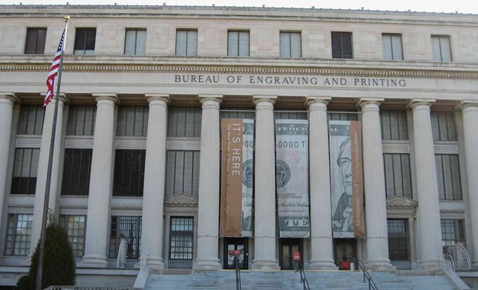
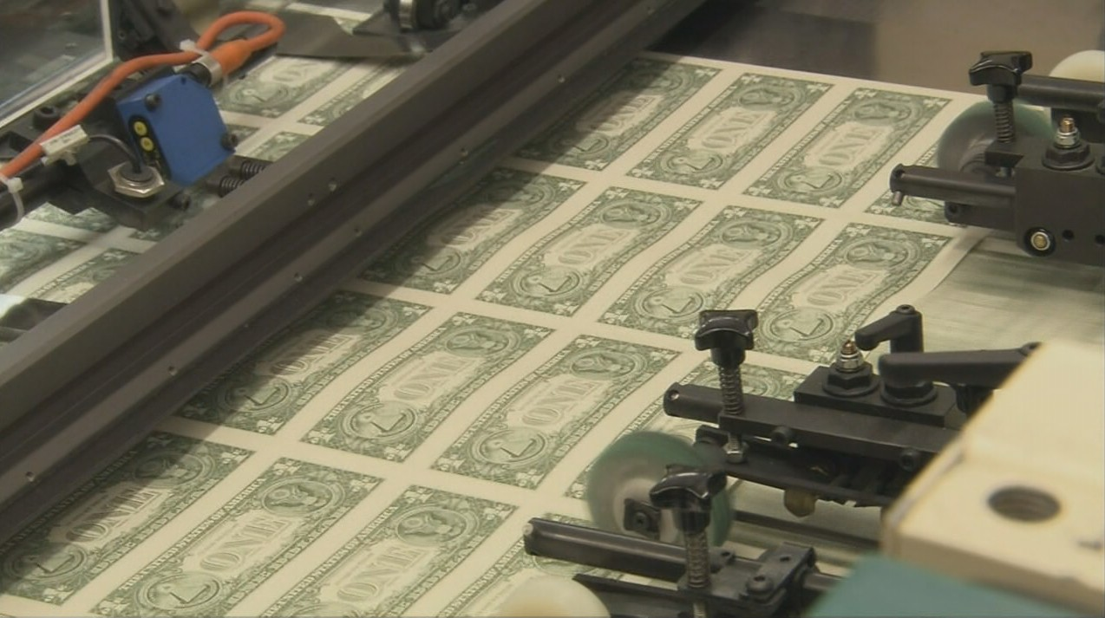
Money
The Federal Reserve does not make the physical dollar bills (the Treasury does)
The Federal Reserve regional banks are responsible for distributing the bills and coins (control money supply)

Slide 9
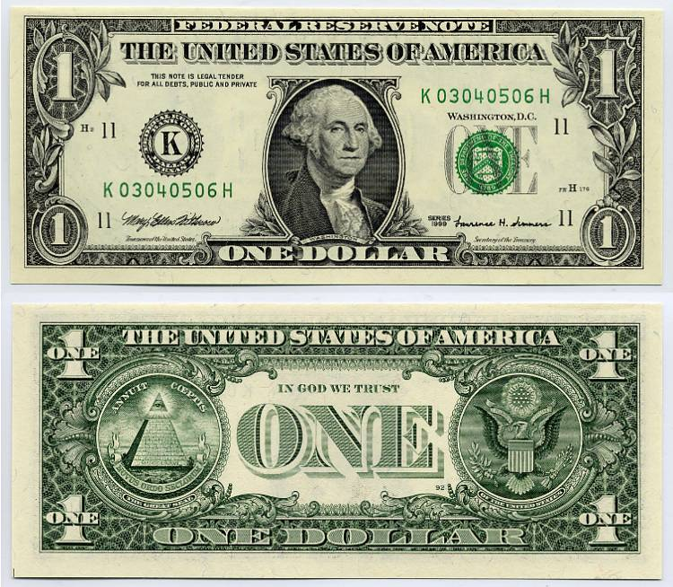
Notes:
Notice at the top of any dollar bill it says “Federal Reserve Note.” This means the bill is backed by the guarantee of the Federal Reserve to be worth something

Slide 10
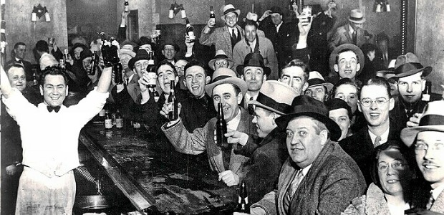
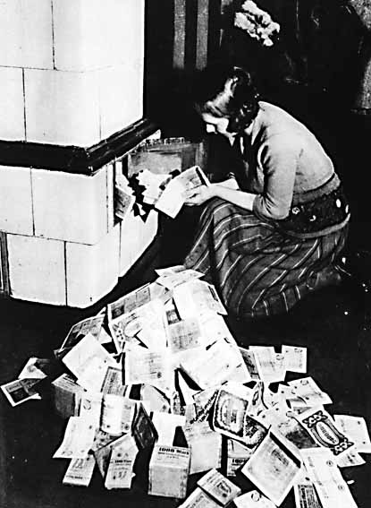


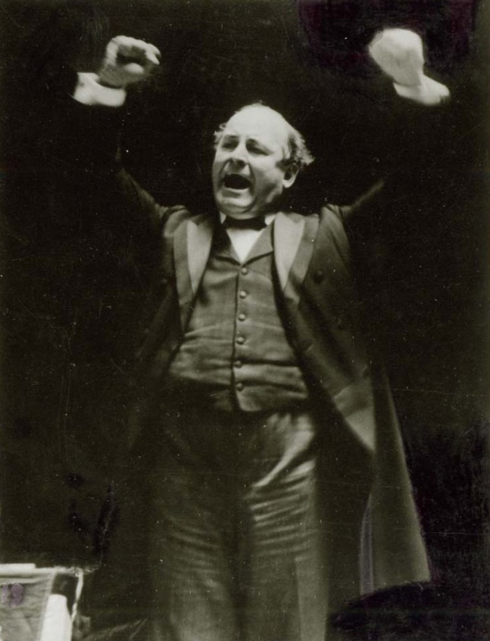
Before the Stock Market Crash of 1929

Slide 11
Origins of Central Banking
Central banks as early as the 17th century were private
Governments saw the need to maintain central bank functions, primarily to issue paper money backed by gold
In the 19th century there were many bank panics. Central banks began to serve as a lender of last resort.

Slide 12
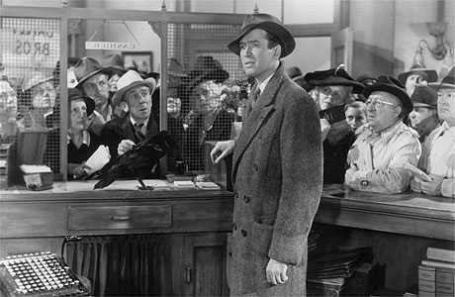
What Makes a Financial Panic?
Financial Panics are caused by sudden loss of confidence in one or more institutions, leading the public to stop funding those institutions through deposits.
It's A Wonderful Life (1946) - 7 min.
Mary Poppins (1964) - 1 min.

Slide 13
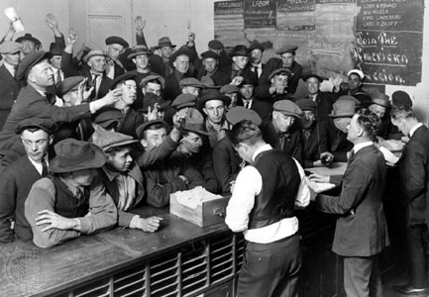
What Makes a Financial Panic?
Panics can cause:
Widespread bank runs
Restrictions on depositors’ access to their funds
Bank failures
Stock market crashes
Short or prolonged economic contractions

Slide 14
Before the Crash
Financial Instability:
Financial stability institutions were private. The largest institutions was the New York Clearing House.
These organizations were unable to provide the stability needed as a lender of last resort, as evident by the numerous banking panics during this era.

Slide 15
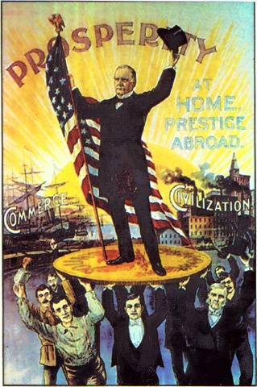
The Gold Standard
The gold standard as an alternative to a central bank:
The value of the currency is fixed in terms of a quantity of gold
The gold standard determines:
Amount of currency in circulation
Price level
Requires limited central bank intervention
Enacted since 1879 except during WWI (US embargo on gold exports)

Slide 16

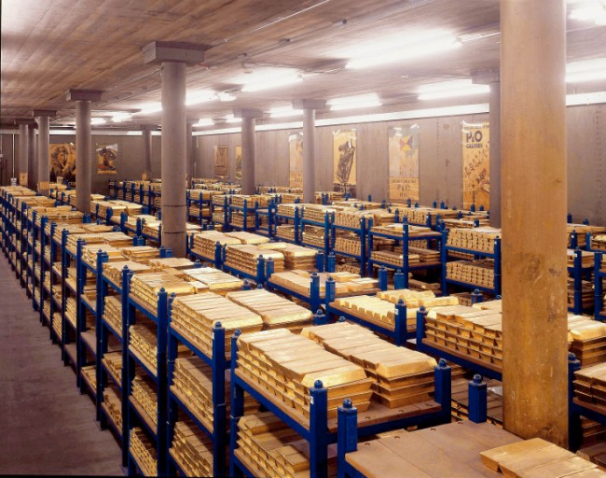
The Gold Standard
Problems:
It cannot be adjusted in response to changing economic conditions
Countries are forced to maintain a fixed exchange rate
Bad policies in one country can be transmitted to other countries if both on gold standard
Subject to speculative attack and ultimate collapse (supply of gold)

Slide 17
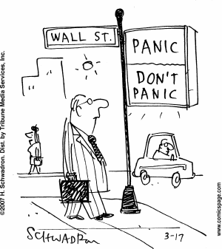
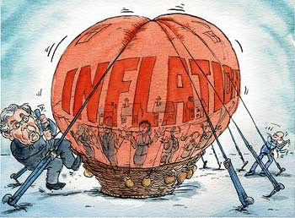
The Gold Standard
Problems continued:
Can cause periods of inflation and deflation in medium run (even though promotes price stability in long run)
Does not prevent frequent financial panics

Slide 18
Before the Crash
Falling Prices and Gold Standard:
A global shortage of gold reduced the U.S. money supply and caused deflation (falling prices).
Famers were squeezed between declining prices for crops and the fixed dollar payments for their mortgages and other debts.
Prices recovered in 1929, but dropped further in the early 1930s.
Commodity Prices

Slide 19
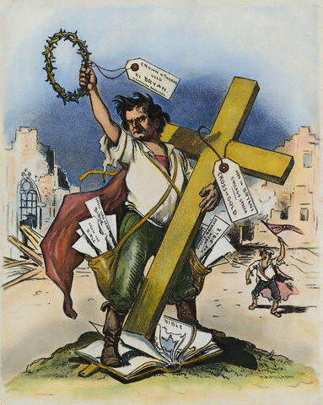
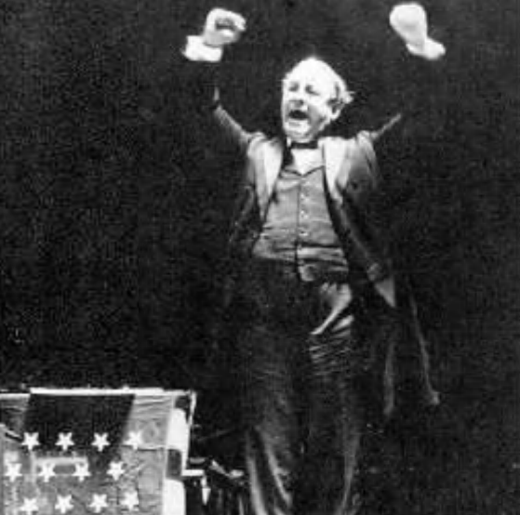
Before the Crash
William Jennings Bryan’s Warning:
“You shall not press down upon the brow of labor this crown of thorns, you shall not crucify mankind upon a cross of gold”
– William Jennings Bryan, July 9, 1896

Slide 20
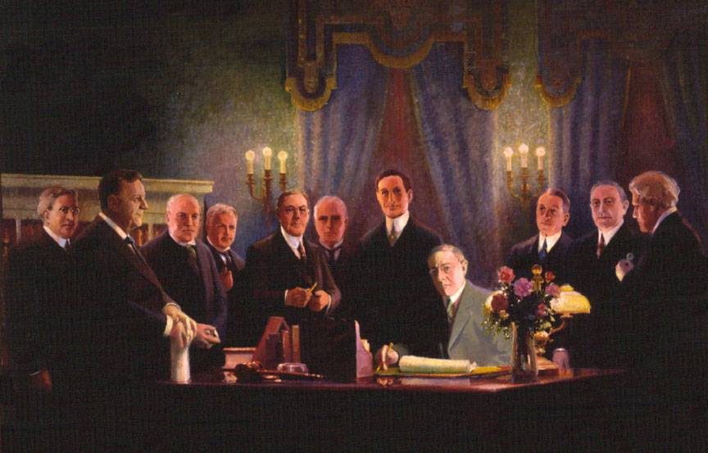
Evolution of the Dual Mandate
The Federal Reserve was created in 1913 in response to the Banking Panic of 1907.
Ultimate responsibility was to act as a lender of last resort.
Also to manage the gold standard to avoid sharp swings in interest rates.
Notes:
Start by talking about what a banking panic is.
There was actually a lot of politics involved in creating the Federal Reserve. Populists at the time were concerned it would be dominated by Wall St. bankers. Didn’t actually get passed until Woodrow Wilson became president.
At the beginning the only responsibility was the lender of last resort, talk about a lender of last resort is.

Slide 21
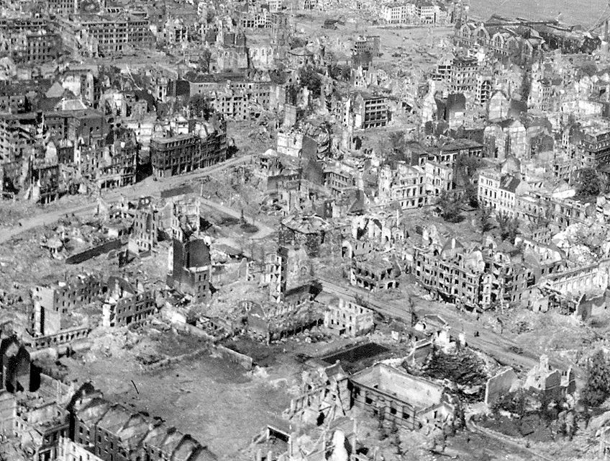
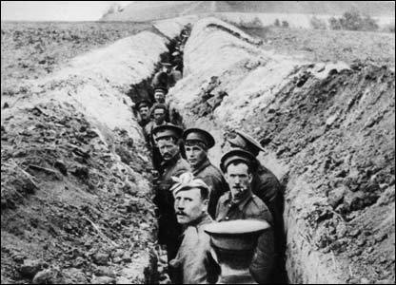
The 1920’s: Post-WWI Europe
British and French politicians demanded that that post-WWI Germany (the Weimar Republic) paid reparations for destroying their economies

Slide 22
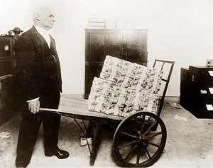
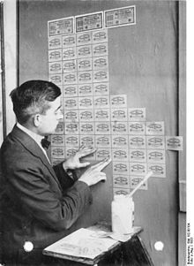
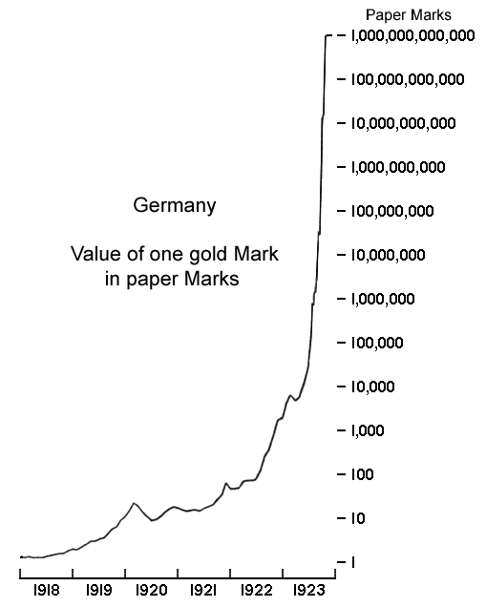
The 1920’s: Post-WWI Europe
Reparations accounted for 1/3 of the German deficit from 1920 to 1923
Forced the government to print money, causing hyperinflation
Prices were so uncontrollable that the currency was abandoned
Notes:
Pictures: Top – In November 1923, inflation reached its peak when the government decided to reissue currency to replace the Mark with a paper currency called the Rentenmark. In order to make new currency, banks turned over the old currency in barrels (by the ton) to be recycled as paper. Before this conversion, the currency lost its value quickly, particularly in 1923 (see lower right graph). Because the currency lost almost all of its value, people reverted to a traditional barter system. People used the Mark to do various things like, burn to heat their home or to use as wallpaper as seen here.

Slide 23
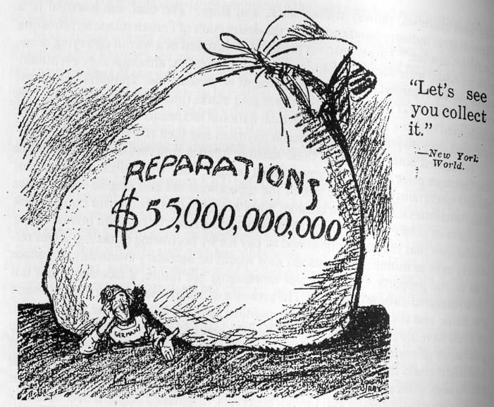
The 1920’s: Post-WWI Europe
Economic conditions were said to help Nazism gain power in Germany

Slide 24
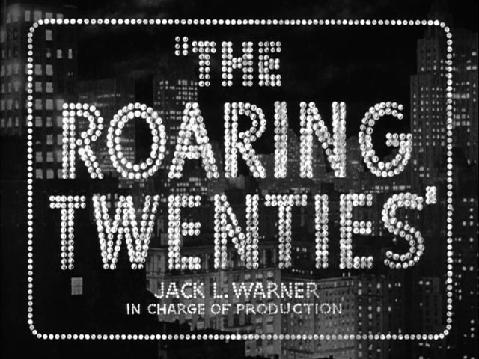

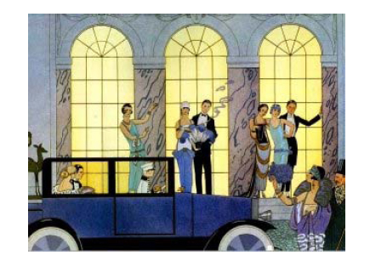
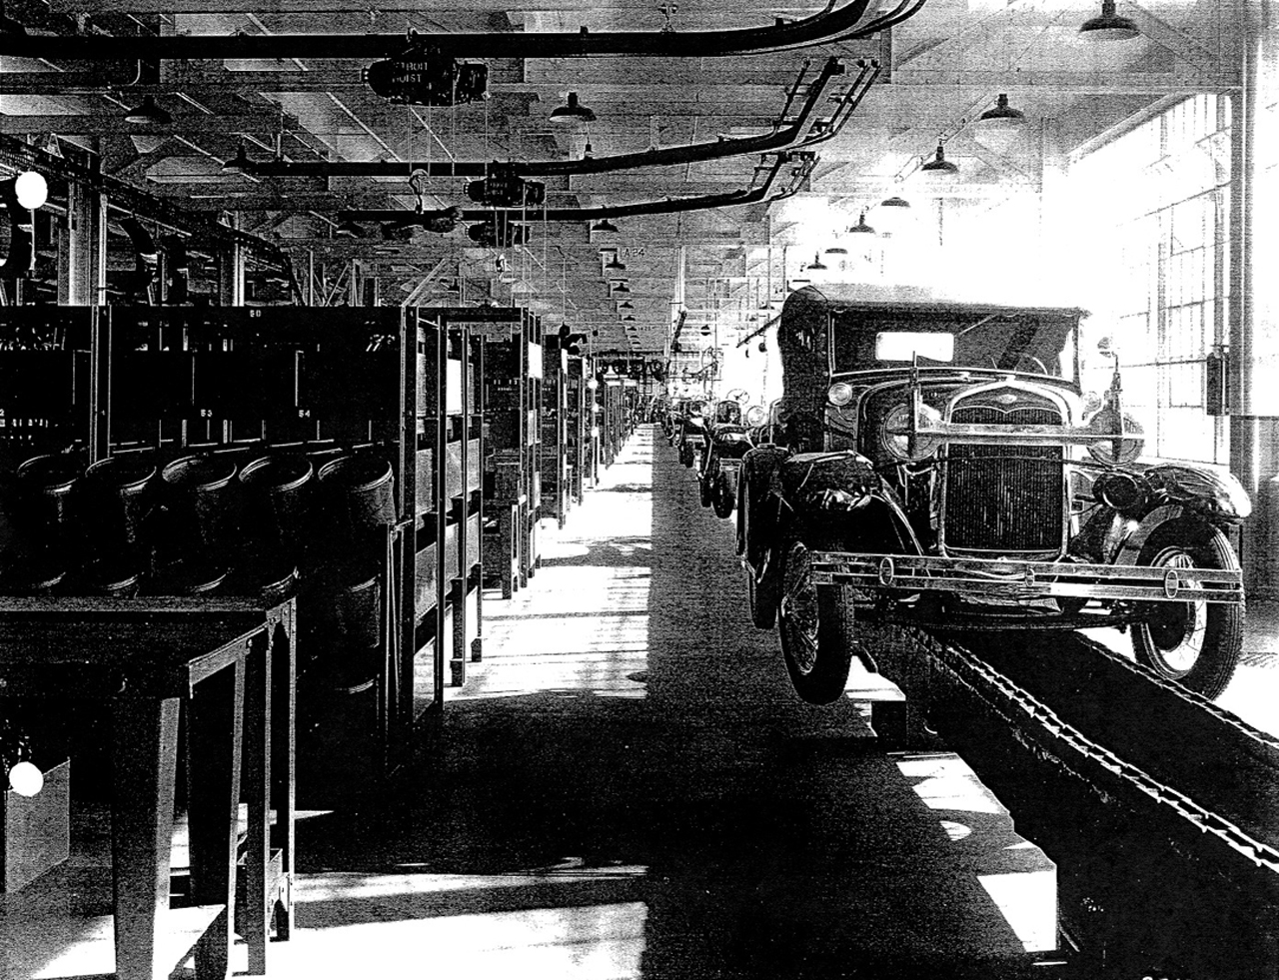
The 1920’s: America
Unlike Europe, the “Roaring Twenties” was a time of prosperity
Production boomed after the introduction of the assembly line
Many speculated in the stock market, living beyond their means.

Slide 25
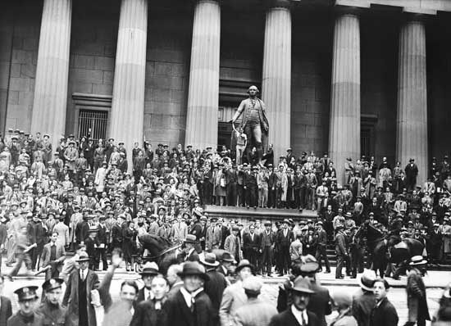
The Stock Market Crash of 1929 and the Great Depression

Slide 26
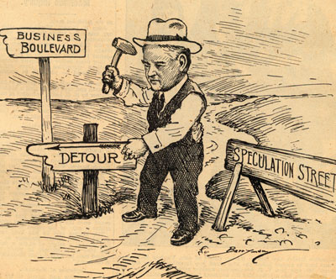
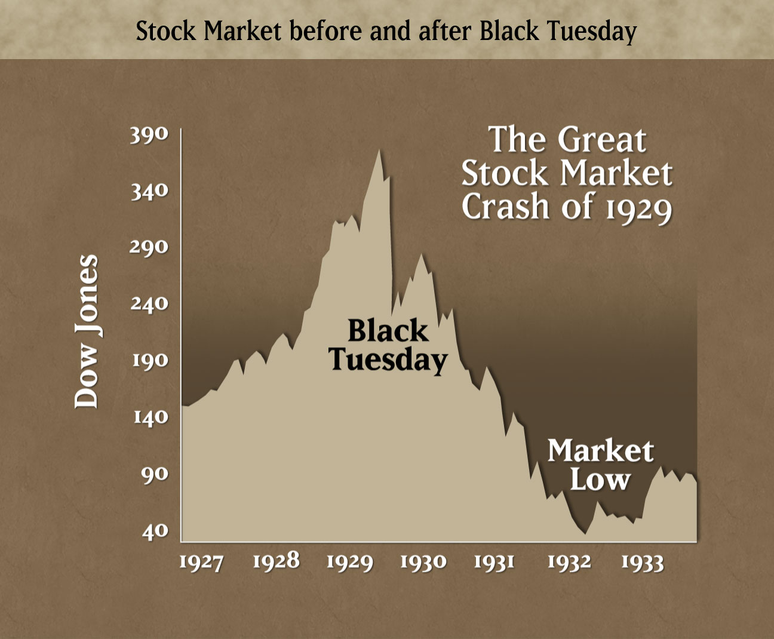
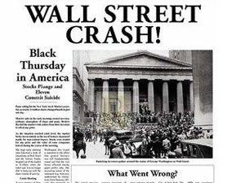
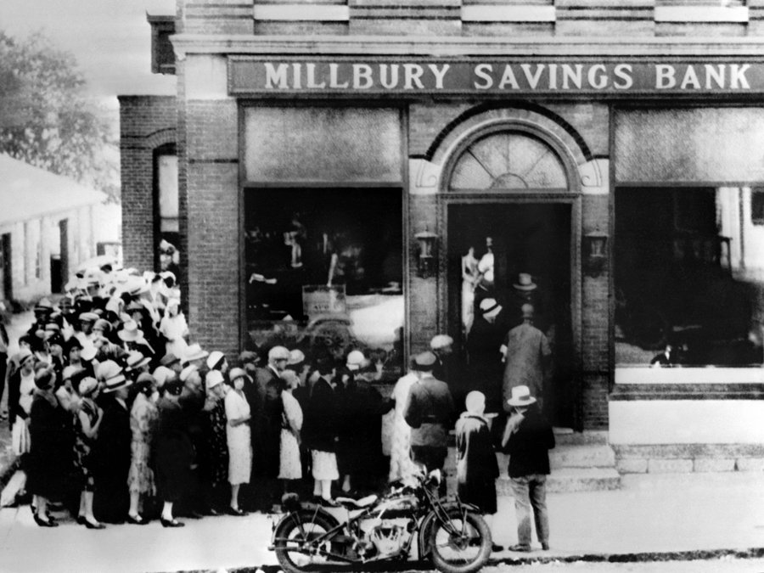
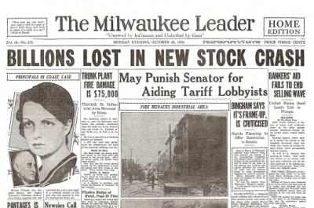
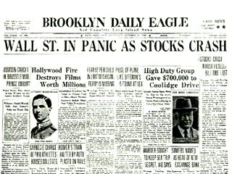
Notes:
Market crashed on October 28th and 29th (see huge dip above the “Black Tuesday”) These are known as Black Monday and Black Tuesday. What caused the crash?
Speculative boom in the late 1920s in production. The first 6 months of 1929 showed large returns for many firms, including those in iron and steel. This caused many to invest heavily in the stock market. Many were convinced that rising prices were going to keep rising, so many invested money that they needed to live on.
This speculation caused an economic bubble
Over supply in wheat caused wheat prices in the US to drop, almost choking out incomes of farming populations. There was a drought, which drove up prices until August when France and Italy boasted of a irregularly larger harvest from Australia, which caused the stock to drop quickly. This spread to other commodity markets, until the market finally started to downturn on October 24, 1929.

Slide 27
What Really Caused the Great Depression?
Break up into 8 groups:
2 groups of construction workers
2 groups of railroad workers
2 groups of farmers
2 groups of teachers
Complete the Budget sheet as instructed at the top for 1928
Once you are finished, each person will get a “Scenario” card – read it to the group.
Continue onto 1933
Compare budgets, discuss what happened among the group

Slide 28
Comparing 1928 to 1933
When your income decreased in 1933, what happened to the % of income spent on housing?
If you kept your job, were there any changes?
What happened if you lost your job?
Even though prices went down, did that help?

Slide 29
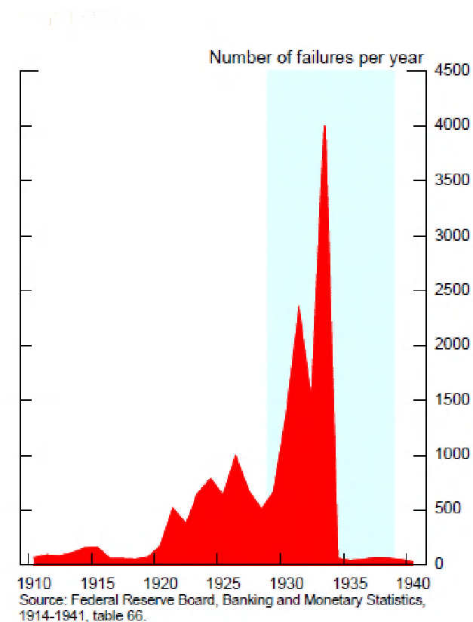
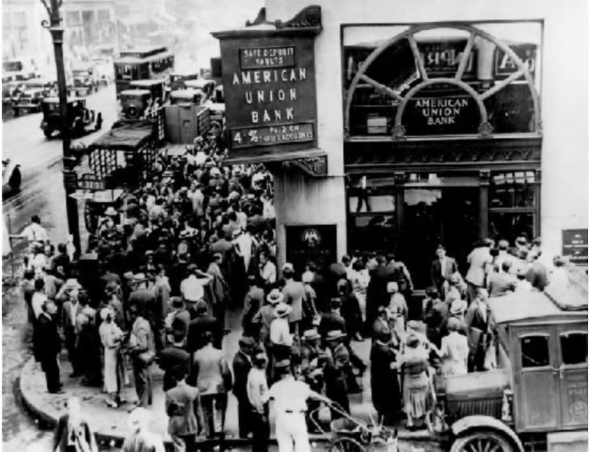
The beginning…
Banks invested deposits in risky assets
Banks failed at alarming rates as panic spread
The role of “Lender of Last Resort” was not filled properly
Many lost all savings

Slide 30
Output and Prices fell…

Slide 31
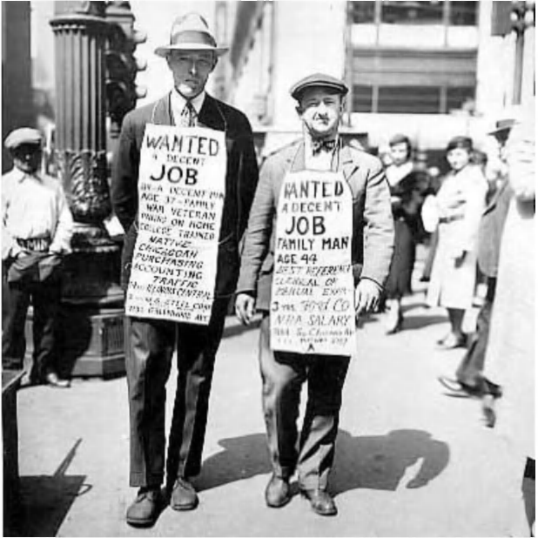
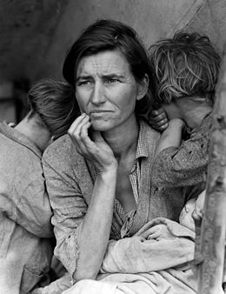
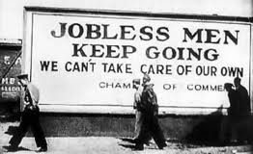
Unemployment Rises

Slide 32
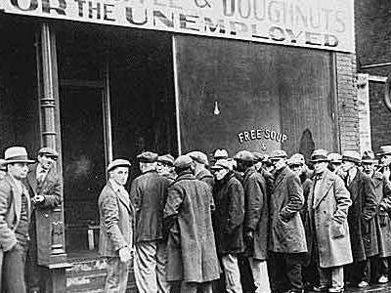

The Great Depression and Employment
The federal government should try to prevent recessions.
Employment Act of 1946. The Fed was not directly mentioned, but later assumed the responsibility.
Notes:
Pretty much says it all in the bullets. After the Employment Act of 1946 it was implied that the Fed should promote max employment.

Slide 33
The Whole World Felt the Effects…
Change in economic indicators 1929-32
 | United States | Great Britain | France | Germany
Industrial Production | -46% | -23% | -24% | -41%
Whole Sale Prices | -32% | -33% | -34% | -29%
Foreign Trade | -70% | -60% | -54% | -61%
Unemployment | +607% | +129% | +214% | +232%

Slide 34
Review: What caused the Great Depression?

Slide 35

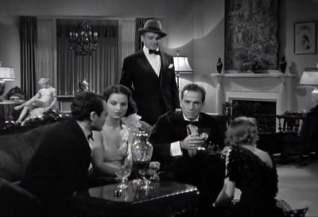


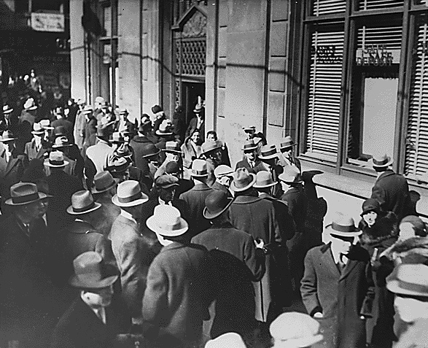


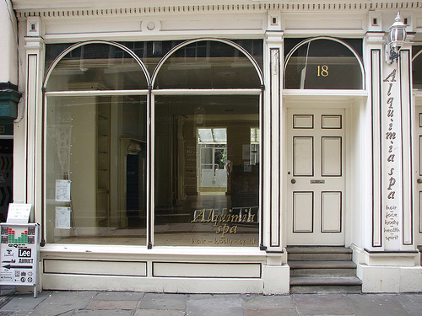
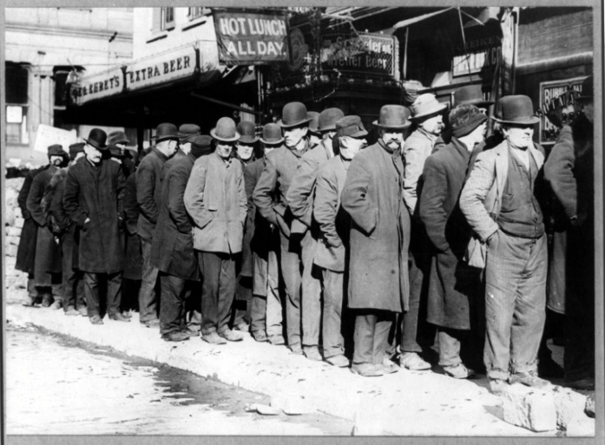
Economic Problems:
Economic Problems from World War I
People Live Beyond their means in the 1920s
Market Bubbles
Burst
Stock Market Crashes
Financial Panics, Bank Runs, and collapse of major financial institutions
Rigid Structure of the Gold Standard
Prices Fall
(Deflation)
Consumption
Falls
Unemployment Skyrockets

Slide 36
Monetary Policy Failures:
Cause: poorly managed gold standard
Tightening of monetary policy from 1928-1929 to stem speculation and preserve gold standard
Monetary contractions are associated with falling prices, output and unemployment
Policy miscalculations transmitted abroad via the gold standard
See universal patterns of DEFLATION
Lack of proper financial structure and regulations
Did not provide enough credit to borrowers
The Federal Reserve failed to act with high unemployment and deflation
In summary: Tight monetary policy leads to falling prices, steep declines in output, and high unemployment

Slide 37
Lessons Learned From the Great Depression

Slide 38
Reconsidering the Fed’s Mandate
The responsibility of the Federal Reserve:
The Board of Governors of the Federal Reserve System and the Federal Open Market Committee shall maintain long run growth of the monetary and credit aggregates commensurate with the economy's long run potential to increase production, so as to promote effectively the goals of maximum employment, stable prices, and moderate long-term interest rates.
-The Federal Reserve Act
This is known as the Dual Mandate of:
(1) Maximum employment
(2) Price stability
Notes:
Top paragraph comes from the Federal Reserve Act, talk about how Congress gave the Fed its responsibilities. The paragraph boils down to the dual mandate- if you have max employment and price stability then you should have moderate long-term interest rates.

Slide 39
Definition of the Dual Mandate
Price Stability: Low and stable inflation.
Fed did not use monetary policy to prevent deflation.
Maximum employment: The level of employment where the economy functions at its potential.
Falling prices led to a collapse in output and employment
Notes:
Let the students shout out answers to the questions.
Benefits of high employment-pretty obvious, people are not unemployed which can take its toll on the economy, also have psychological effects, etc. Try to link it back to when you talked about unemployment during the deflation slides.
Price stability- Try to link back to talking about the consequences of inflation. Also, if prices are stable firms’ and household know what to expect so they can make better savings and investment decisions.

Slide 40
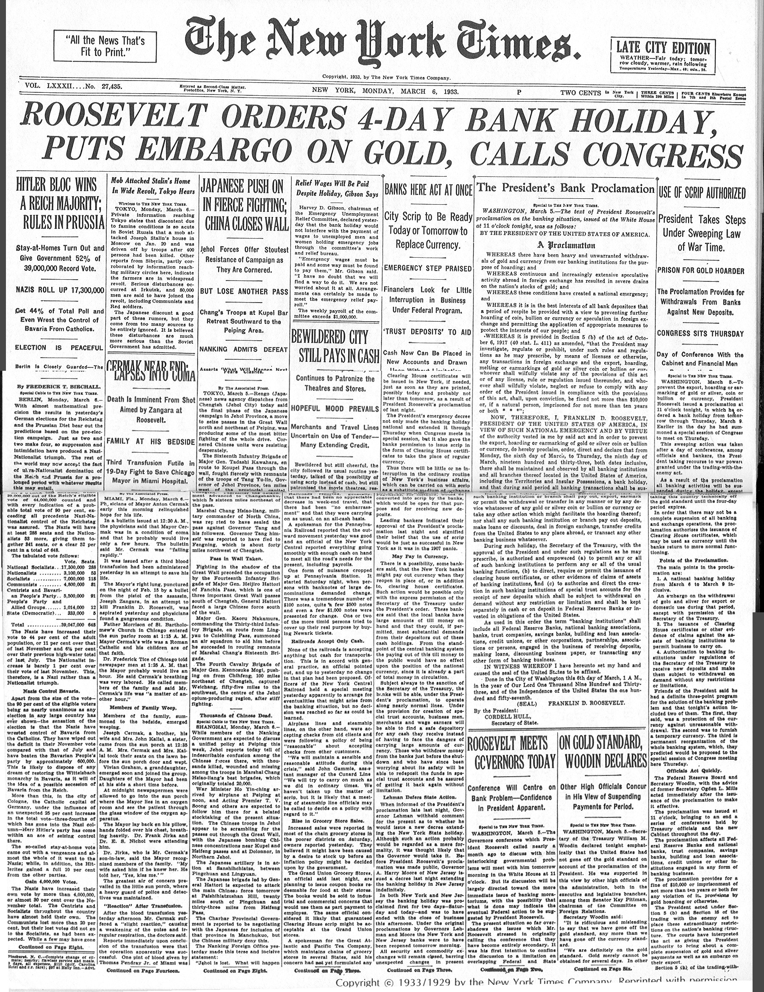
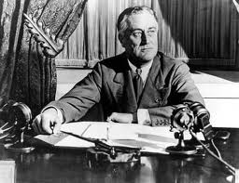
FDR: Deposit Insurance
After 1929, bank runs continued and many people hoarded gold, making the Gold Standard untenable.
March 1933: FDR declares nationwide bank moratorium, stops gold payouts, and issues “deposit insurance” to prevent further bank runs.
Notes:
June 5, 1933: Congress enacted joint resolution nullifying the right of creditors to demand payment in gold, requiring individuals to exchange Federal Reserve gold coins in for paper currency.

Slide 41
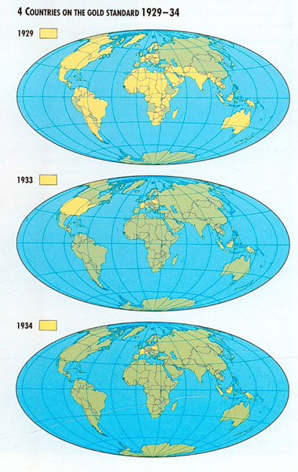
FDR: US off Gold Standard
Countries on the gold standard experienced deflation
Only escaped by abandoning the gold standard
Re-established domestic monetary policy as we have today

Slide 42
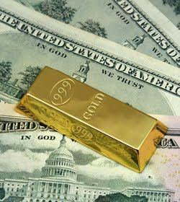
FDR: US off Gold Standard
June 5, 1933: Congress takes steps to move away from the Gold Standard and stabilize monetary policy.
Monetary policy becomes less tight
Deflation stops
Economy starts to recovery, slowly
August 15, 1971: Nixon ends fixed US$ to gold conversion rate, completely ending gold standard.

Slide 43



Work: Microeconomic Surveys, Division of Research and Statistics
Hometown: Columbia, MD
College: University of Maryland, College Park
Degree: B.A. Economics
Future plans: Currently pursuing a MA in Applied Economics
Favorite part of my job: Finding obscure details buried in surveys that teach us a lot about a person.
Robert Argento
Work: Financial and Macroeconomic Stability Studies, Office of Financial Stability and Policy Research
Hometown: College Station, TX
College: Texas A&M University and the George Bush School of Government and Public Service
Degree: B.A. History/Political Science, Master of Public Service Administration
Future plans: PhD in Economics, hopefully coming back to the Fed System as an Economist
Favorite part of my job: Directly impacting public policy that affects the entire U.S. economy.
Rachel Boenigk
Work: Monetary Studies Unit, Division of Monetary Affairs
Hometown: Idaho Falls, ID
College: The Catholic University of America
Degree: B.S. Mathematics
Future plans: Graduate school in Economics or Public Policy
Favorite part of my job: Getting first hand exposure to the research and policy making process.
Christine Garnier

